Slide 1
PHP: An Overview
Chapter 11

Slide 2
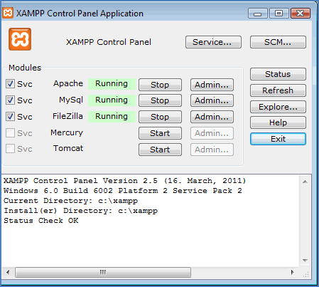
11.1
A Brief History of PHP

Slide 3
PHP
created by Rasmus Lerdorf
developed the language to track visitors to his website
released this package in 1995
1997 PHP3 was released and included built-in database support and the ability to handle forms
businesses and large websites need more functionality to store data than possible with arrays
Businesses use databases to store information on customers, inventory, employees, etc.
PHP can be used to communicate between a web page that a user will see on his or her computer (i.e., the client) and the database which resides elsewhere (i.e., on the server)
New information can be entered into a database from a form on the user's computer
The form processes that information and adds it to the appropriate databases
PHP allows information to flow the other way too—from the server to the client
When you return to a site where you have an account, your information is retrieved from the databases on that site's server and returned to you, the client. That's how websites can greet you by name, display your ordering history, and much more
PHP is open-source code, free to everyone
If you’re looking for a particular script, chances are someone else within the PHP community has already created something similar and it probably is available

Slide 4
What Does a Server Do?
When a user clicks a link, a request is sent to a server. The server sends the requested page back to the client (the user's computer).
The URL tells the browser what page or other resource (a video, a song, etc.) to get
sample URL: http://www.jackie.com/courses/beading.html
http:// indicates that the protocol HyperText Transfer Protocol will be used
the web page requested resides on the web server www.jackie.com
there is folder named courses
it contains a file named beading.html
this file is the resource requested
A communications protocol is a system of digital message formats and rules for exchanging messages between computing systems
http is the most common communications protocol
others include ftp, IP, and TCP
hostname, www.jackie.com, is actually an IP address, a series of numbers
An Internet Domain Name System (DNS) maintains a database of hostnames and their corresponding IP addresses
automatically translates the text hostname to its IP address

Slide 5
HTTP get and post Request Types
when a user performs a website search, he wants to get some information that resides on the site's server
often the user wants to send information to a server
therefore, the get and post request types are the two most common HTTP request types
a get request appends data to the URL to specify what it should get
The information requested is sent as form data and the server's ability to process form data is used.
a post request is similar

Slide 6
The Apache HTTP Server
An Apache Web Server is commonly called Apache
is a free open-source web server
was originally created for Unix, but there are now versions that run under other platforms such as Linux and Windows
To communicate between client and server, you must have server software on your computer or you must have access to a server

Slide 7
The MySQL Database
a database is an organized collection of data
The databases we refer to in this chapter are relational databases.
information in the database is stored in tables which contain groups of related data called records.
Example: a business might store various information about its customers
One table might hold the demographic information about a customer.
All information relating to one customer comprises a single record.
Each data item in a record is called a field.
A second table might hold a customer's purchasing history.
A single record would be the data referring to one customer and the fields in this table would be the specific information (purchase date, items purchased, etc.).
A third table might hold the business's inventory.
same business owner might have another database to store each employee as a record
The fields would be different from the customer database.
They might include hours worked, pay rate, tax deductions, and so forth.
. A third database could include information about inventory .
A record might be the name of a particular item, cost, number on hand.
Databases are made up of records and records are made up of fields.
MySQL is a free open-source relational database system, especially popular for web applications.

Slide 8
PHP and XAMPP
PHP is a general-purpose scripting language that is especially suited for web development
It can be embedded into HTML
To get everything we need—Apache, MySQL, and PHP—can install free software called XAMPP:
X: for "cross", because it is cross-platform (can be used on many different platforms)
Apache HTTP Server
MySQL
PHP and Perl (although we do not need Perl in this text)

Slide 9
11.2
XAMPP

Slide 10
Installing XAMPP Go to: http://www.apachefriends.org/en/xampp.html
Select your platform.
Be sure to read the pertinent information provided for your platform.
Note: It is a pretty large file.
The download could take up to an hour.
Oce downloaded, installing it takes only a few minutes.
It is recommended to accept the default installation.
Try It: the Control Panel should look as shown:

Slide 11
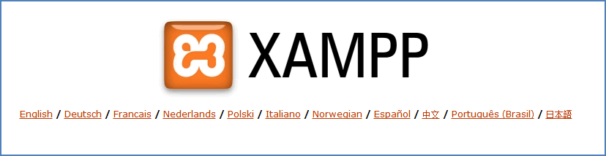
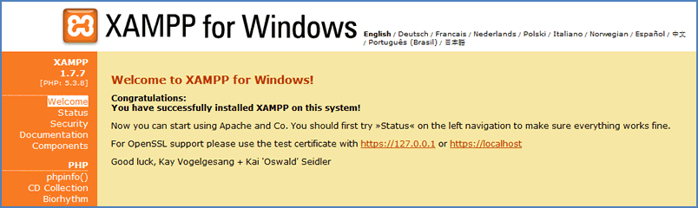
Linux users: To start XAMPP open a shell and enter the following command:
/opt/lamp/lamp start
To stop, enter the following command:
/opt/lamp/lamp stop
All Users: To test that your program is properly installed, go to any browser and enter the following: http://localhost/
If everything is working correctly, you should see a display similar to the following:
On a Windows machine and click English, you should see a screen similar to:

Slide 12
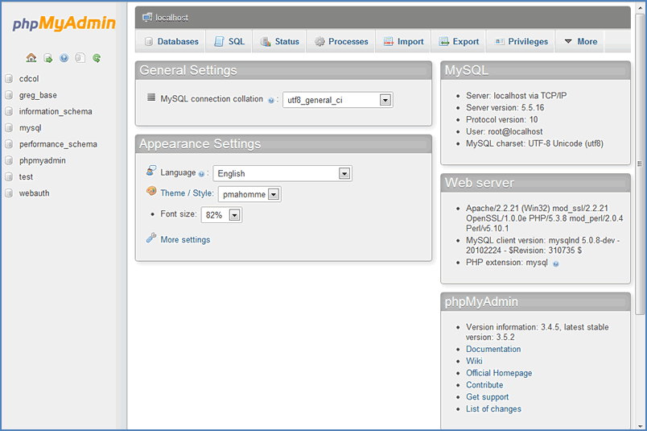
Get Started
In the Control Panel, click Start for Apache and MySQL.
You're now running a server!
Next enable PHP. Click the Admin button next to MySQL in the Control Panel and the phpMyAdmin screen will open as shown:

Slide 13
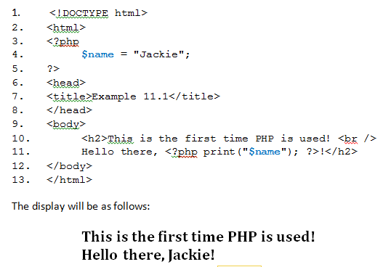
A First PHP Program
PHP can be placed anywhere in the HTML
The PHP print() function puts it on the screen
Source code doesn’t show the PHP because all PHP operations occur on the server

Slide 14
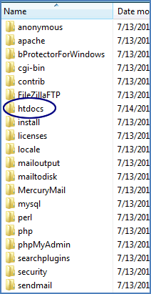
11.3
PHP Basics

Slide 15
PHP File Names, the htdocs Folder, and Viewing Your PHP Pages
if a page has any PHP included at all—even one line—the page must have the .php extension
if you tried Example 11.1 and named the file hello.html, the display would simply be as follows:
This is the first time PHP is used! Hello there, !
browser ignores code that it considers unintelligible (the PHP statements)
if you view the page's source code, you will see the unprocessed PHP statements
you need to name this page something like hello.php
if you then opened the hello.php page on your computer in the ordinary way—putting in the path to that file—the display would still be:
This is the first time PHP is used! Hello there, !

Slide 16
The htdocs Folder
all PHP documents must be stored in the htdocs folder.
This folder was created when XAMPP was installed
See the listing of folders in the xampp folder:

Slide 17
The localhost
To open this page on your computer and allow the server to process the PHP before the browser takes over, do not create a path directly to this file.
Instead, tell the browser to use the local host—the Apache server that was installed with XAMPP. The path is as follows:
localhost/hello.php
By using localhost in the path, the computer knows the server is on the local machine and knows to look in the htdocs folder.
Now the display will appear as desired:
This is the first time PHP is used! Hello there, Jackie!

Slide 18
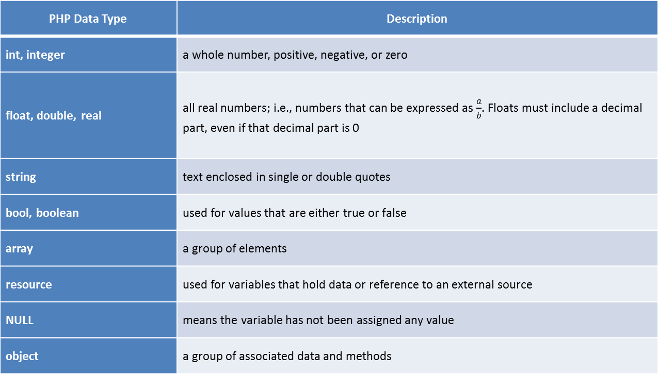
PHP Data Types
PHP Data Type | Description
int, integer | a whole number, positive, negative, or zero
float, double, real | all real numbers; i.e., numbers that can be expressed as $\frac{a}{b}$. Floats must include a decimal part, even if that decimal part is 0
string | text enclosed in single or double quotes
bool, boolean | used for values that are either true or false
array | a group of elements
resource | used for variables that hold data or reference to an external source
NULL | means the variable has not been assigned any value
object | a group of associated data and methods

Slide 19
PHP Variables
PHP variable names begin with $
PHP variables, like JavaScript variables, are loosely typed
Examples:
$username = 'puppypal'; // declares a string variable with the value puppypal
$points = 234; // declares an integer variable with the value 234
$cost = 45.87; // declares a float variable with the value 45.87
$response = true; // declares a Boolean variable with the value true
Note the double slashes (//) make the text following into a single-line comment

Slide 20
Converting Data Types with the settype() and gettype() Methods and type casting
The settype() method takes two arguments
first argument is the variable whose type will be changed
second argument is the variable's new type
syntax for settype() is as follows:
settype($variableName, "new_datatype");
The gettype() method takes only one argument
the name of the variable whose type will be returned
syntax for gettype() is as follows:
gettype($variableName);
type casting changes a variables type but
rather than changing the value of the variable, when casting is used, a temporary copy of the variable's value is created in memory
syntax to cast one variable to another type is as follows:
(datatype_desired) $variableName;

Slide 21
PHP Keywords
PHP Keywords
abstract | declare | endswitch | include | require
and | default | endwhile | include_once | require_once
array() | die() | eval() | instanceof | return
as | do | exit() | interface | static
break | echo | extends | isset() | throw
callable | else | final | list() | trait
case | elseif | for | new | try
catch | empty() | foreach | or | unset()
class | enddeclare | function | print | use
clone | endfor | global | private | var
const | endforeach | if | protected | while
continue | endif | implements | public | xor

Slide 22
Unary and Ternary Operators
unary operators: act on a single value
Example:
the NOT operator takes a boolean value (true or false) and returns the opposite
if $choice = true; then !$choice = false;
other unary operators are the increment (++) and decrement (--) operators
one ternary operator in PHP takes three values
not truly an operator in the sense that it does not evaluate to a variable
is a conditional statement; evaluates to the result of whichever condition is true:
(expression_1) ? (expression_2) : (expression_3);
expression will evaluate to the result of expression_2 if expression_1 is true
if expression_1 is false, it will evaluate to the result of expression_3
is also possible to leave out the middle expression:
(expression_1) ?: (expression_3);
it will return the value of expression_1 if expression_1 is true
if expression_1 is false, it will evaluate to the result of expression_3

Slide 23
Binary Operators
Operator | Description
Arithmetic Operators
+ | addition
- | subtraction
* | multiplication
/ | division
% | modulus
Comparison Operators
< | less than
> | greater than
<= | less than or equal to
>= | greater than or equal to
== | equal to
!= | not equal to
=== | identical: true if the two values are the same and have the same type
!== | not identical: true if the two values are not same or have different types
Logical Operators
&& | AND
|| | OR
and | does same thing as && but has lower precedence
or | does same thing as || but has lower precedence
Concatenation Operators
. | concatenates two strings
.= | appends the argument on right side to argument on left

Slide 24
The Concatenation Operator
two string operators:
the concatenation operator concatenates two strings
the concatenating assignment operator appends the argument on the right side to the argument on the left side
The concatenation operator is a dot (‘.’)
syntax for the concatenation operator is:
argument1 . argument2;
The concatenating assignment operator is a dot and an equals sign (‘.=')
syntax for the concatenating assignment operator is as follows:
argument1 .= argument2;
(Spaces before and after these operators is optional and is a matter of preference )

Slide 25
11.4
Using Conditionals and Loops

Slide 26
The if Structure
Logic is same as in JavaScript
The syntax for an if structure is as follows:
if(condition):
result if condition is true;
endif;
The syntax for an if...elseif structure is as follows:
if(condition):
result if condition is true;
elseif (condition):
result if condition is true;
endif;
And the syntax for an if...elseif...else structure is as follows:
if(condition):
result if condition is true;
elseif (condition):
result if condition is true;
else:
result;
endif;

Slide 27
The echo Construct
Previously we used the print() method to pass information from PHP code to a web page
similar to the JavaScript document.write() statement
the echo construct does the same thing
is shorter
often easier to use
syntax:
<?php echo "Hi there!"; ?>
will output the text "Hi there!"
sometimes print() is more appropriate than echo because print()behaves like a function
can use either one

Slide 28
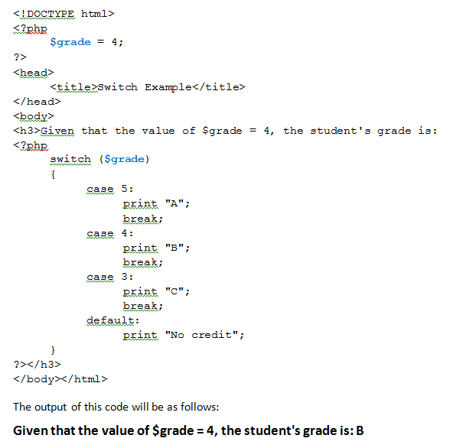
The switch Statement

Slide 29
Repetitions and Loops: PHP loop structures are the same as JavaScript
syntax for a while loop:
while (expression)
{
statements to be executed
}
----------------------------------
or:
while (expression):
statements to be executed
endwhile;
can either group the statements between curly braces or use the endwhile; statement (must include the : after the while())
----------------------------
one syntax for the do...while loop:
do
{
statements to be executed
} while (condition);
syntax for the for loop:
for ($variable = start_value; test_condition; increment)
{
statements to be executed
}
---------------------------------
the alternate syntax:
for ($variable = start_value; test_condition; increment):
statements to be executed
endfor;
--------------------------
Note: if you choose the second syntax, as with the while loop, you must end the loop with the endfor; (or endwhile;) statement that includes a semicolon

Slide 30
11.5
Arrays and Strings

Slide 31
Arrays
PHP allows you to store data in arrays
elements of an array behave as variables
arrays are used in the same manner as JavaScript and other programming languages—to store many related elements
array names in PHP begin with the $
individual array elements are accessed by using the array's name and the element's index number, enclosed in square brackets ([ ])
if a value is assigned to an element in an array but the array does not exist, PHP creates that array
if an array does exist but a value is assigned to an element without indicating an index, the new element will be appended to the end of the array
several ways to initialize an array. The array function can be used or you can simply start declaring array elements

Slide 32
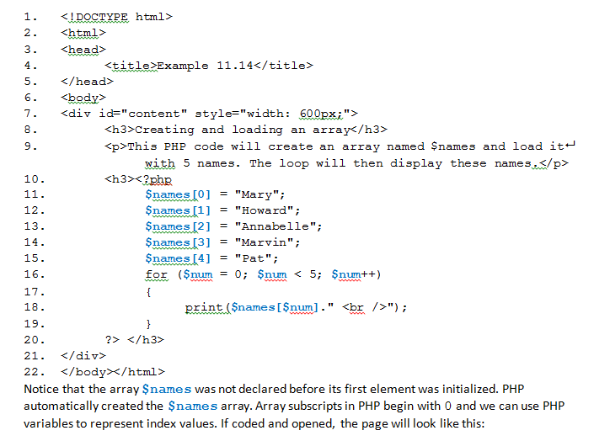
Creating an Array “on the fly”

Slide 33
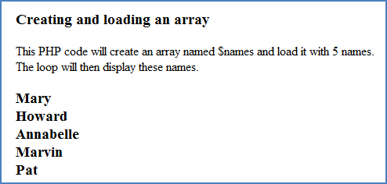

Slide 34
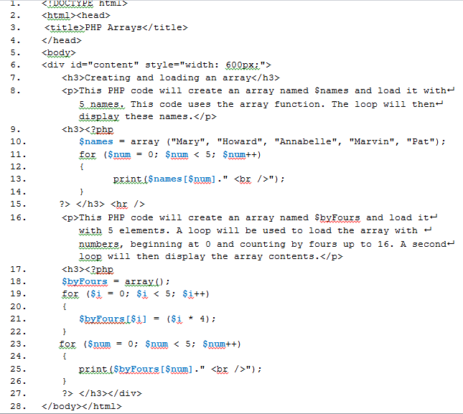
Creating Arrays with the array function and with a Loop

Slide 35
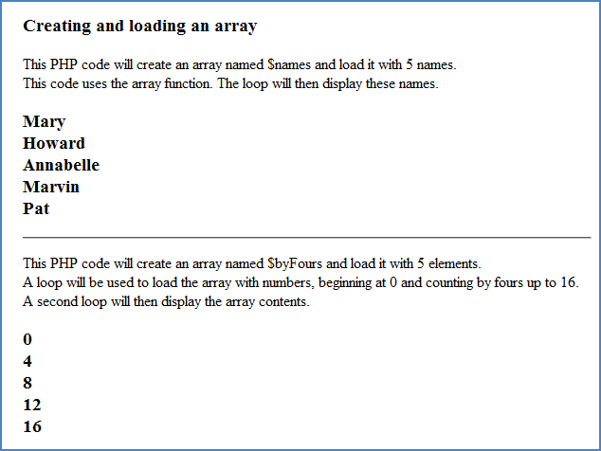
Results

Slide 36
The reset() Method and The foreach Construct
The reset() method resets the computer's internal pointer to the first element of an array
syntax is: reset($array_name)
The foreach construct is an easy way to iterate over arrays
works on arrays and objects only
automatically resets the computer's internal pointer to the first element of an array so when using foreach, you do not need to use the reset() method
syntax for the foreach construct is as follows:
foreach($array_name as $element ==> $value)
{
statements to be executed
}
foreach uses the as keyword and the ==> operator
value on left of the ==> operator is the index of the array element to begin with
value on right of the ==> operator is the value of that element

Slide 37
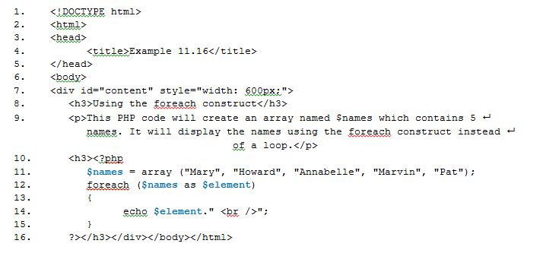
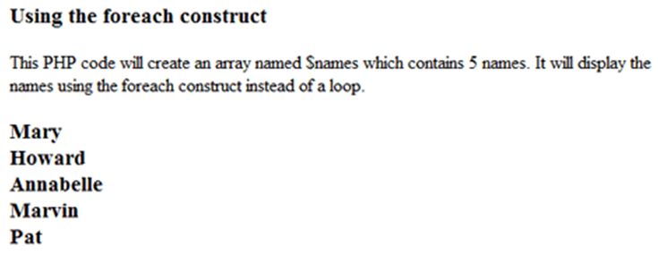

Slide 38
Searching for Expressions The preg_match() and preg_replace() Methods
a regular expression is a pattern of characters
often need to match specific characters to items in an array or database
the PHP preg_match() function is used in these situations
first parameter in this method is the regular expression to search for
regular expressions can contain special characters and some special characters identify specific patterns
the caret (^) matches the beginning of a string
the dollar sign ($) matches the end of a string
the dot (.) matches any single character
example:
preg_match("/^cat/", $string) searches for the pattern "cat" in the beginning of the string
preg_match("/cat$/", $string) searches for the pattern "cat" at the end of the string

Slide 39
More about the preg_match() and preg_replace() Methods
can add a bracket expression containing a list of characters enclosed in square brackets ([ ])
the \b before and after parentheses indicates beginning or end of a word (it means we are searching for a match to a whole word)
the /i indicates that the match can be case-insensitive
example:
preg_match("/\b(cat[a-z]+\b/", $string) searches for any word beginning with the pattern "cat"
preg_match("/\b([a-z]*cat\b/i", $string) searches for any word ending with the pattern "cat"
third parameter in the preg_match() method, $match, is optional
is an array that stores matches to the regular expression
first element stores the text that matches the full pattern
second element has the text that matched the first captured subpattern and so on
a loop can be used to display the results of this array
example:
preg_match("/\b(cat[a-z]+\b/", $string, $match);
print ("Word found that begins with c-a-t is: ".$match[1]);
This will display the first whole word that begins with the pattern "cat"

Slide 40
PHP Quantifiers
Quantifier | Number of Matches
{n} | exactly n times
{m, n} | between m and n times, inclusive
{n, } | n or more times
+ | one or more times
* | zero or more times
? | zero or one time

Slide 41
Some PHP Regular Expression Character Classes
Character Class | Description
alnum | alphanumeric characters (i.e., letters [a-zA-Z] or digits [0-9])
alpha | letters (i.e., [a-zA-Z])
digit | digits
space | white space
lower | lowercase letters
upper | uppercase letters

